Slide 1
WOMART SALES PREDICTION
J.Vivekanand

Slide 2
INTRODUCTION
WOMart is a leading nutrition and supplement retail chain that offers a comprehensive range of products for all your wellness and fitness needs. WOMart follows a multi-channel distribution strategy with 350+ retail stores spread across 100+ cities. Effective forecasting for store sales gives essential insight into upcoming cash flow, meaning WOMart can more accurately plan the cashflow at the store level. Sales data for 18 months from 365 stores of WOMart is available along with information on Store Type, Location Type for each store, Region Code for every store, Discount provided by the store on every day, Number of Orders everyday etc.

Slide 3
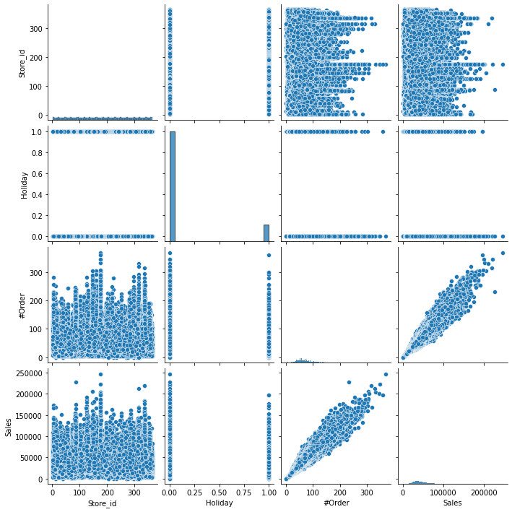
VARIABLES RELATION
From the pairplot, it is observed
that #Order and Sales are linearly
related.

Slide 4
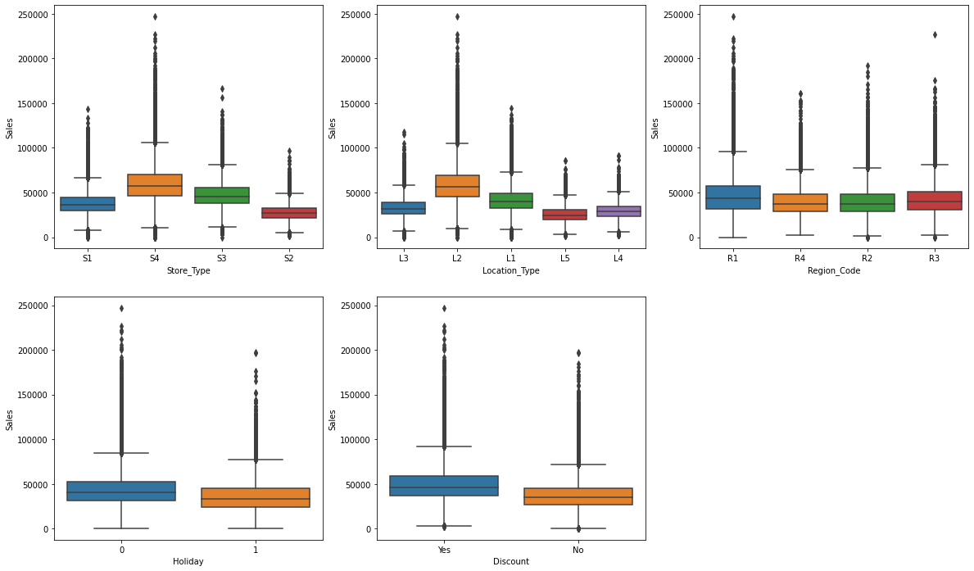
SALES DISTRIBUTUION
From the below boxplots, it can be observed:
Sales is more when Discount is available
Sales did not make much difference on holidays, in fact sales are lesser on holidays

Slide 5
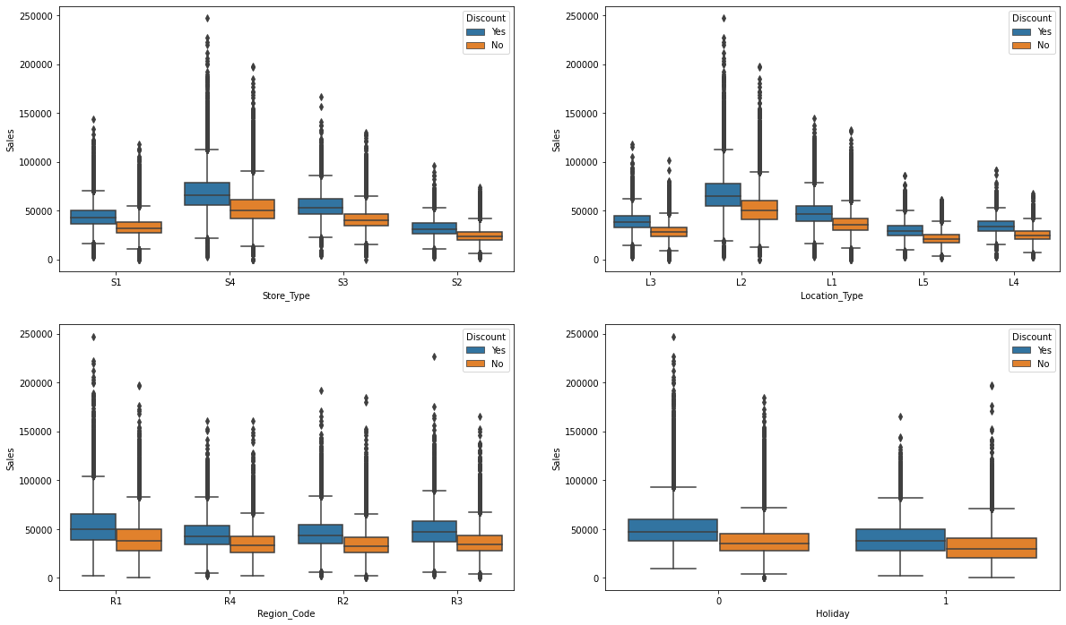
DISCOUNT AFFECT ON SALES
From the below boxplot, it is clearly evident that Sales are more when Discount is available.

Slide 6
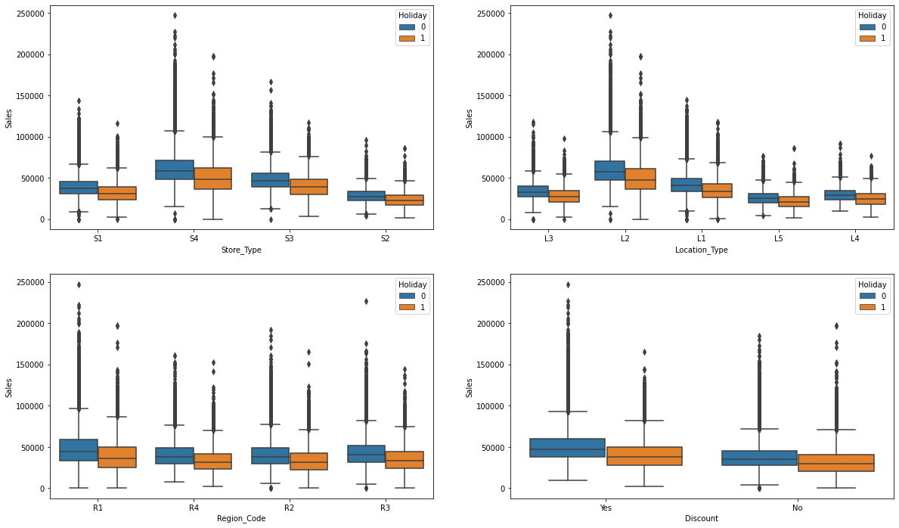
HOLIDAY AFFECT ON SALES
From the below boxplot, it is evident that Sales were much lower on Holidays.

Slide 7
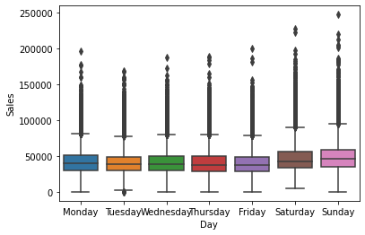
DAY OF WEEK AFFECT ON SALES
From the below boxplot, no proper conclusion can be made. But a slight increase in sales can be observed on Saturday and Sunday, i.e weekend.

Slide 8
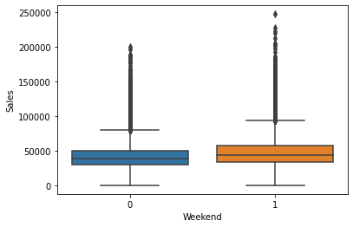
WEEKEND AFFECT ON SALES
It can be observed that Sales are slightly more on weekends than weekdays,

Slide 9
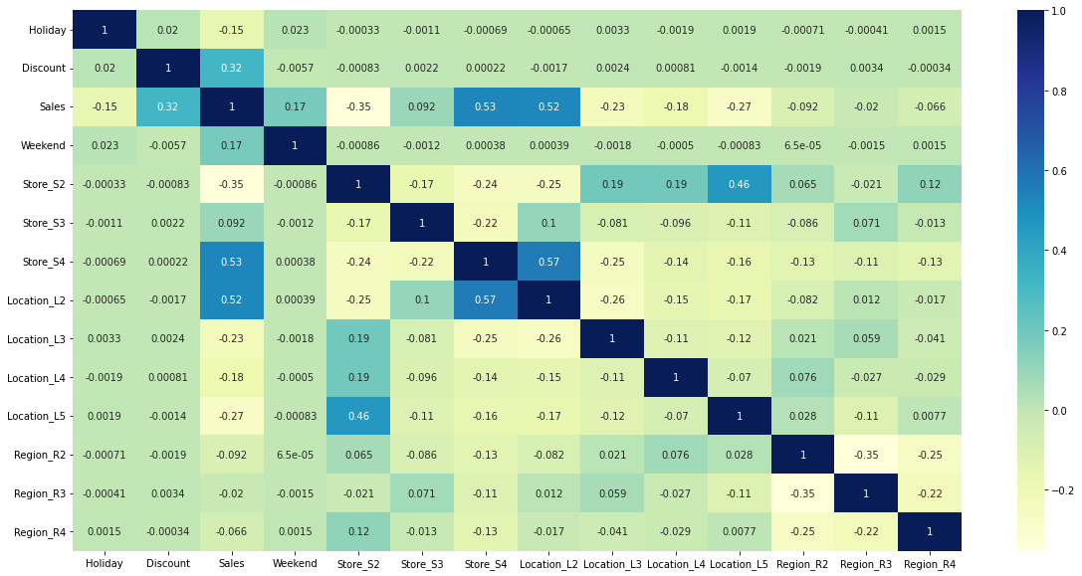
CORRELATION

Slide 10
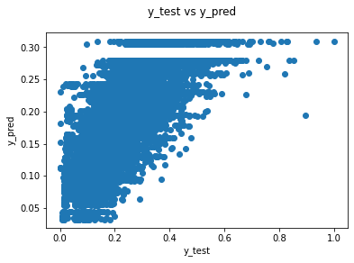
LOGISTIC REGRESSION

Slide 11
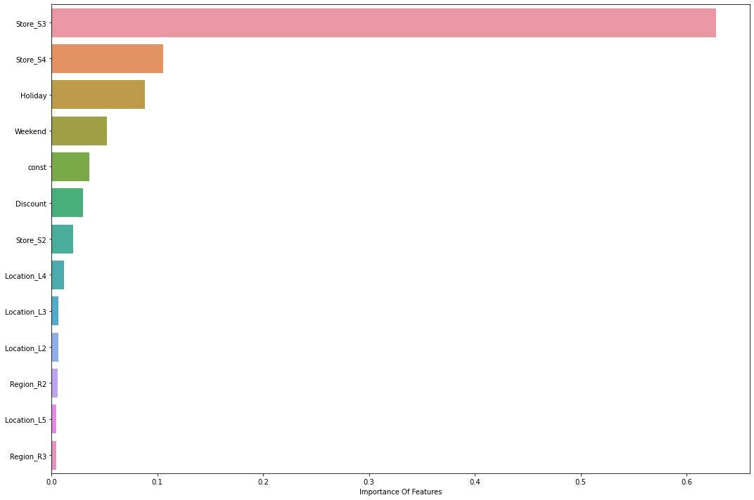
FEATURE IMPORTANCE

Slide 12
THANK YOU

